Slide 1
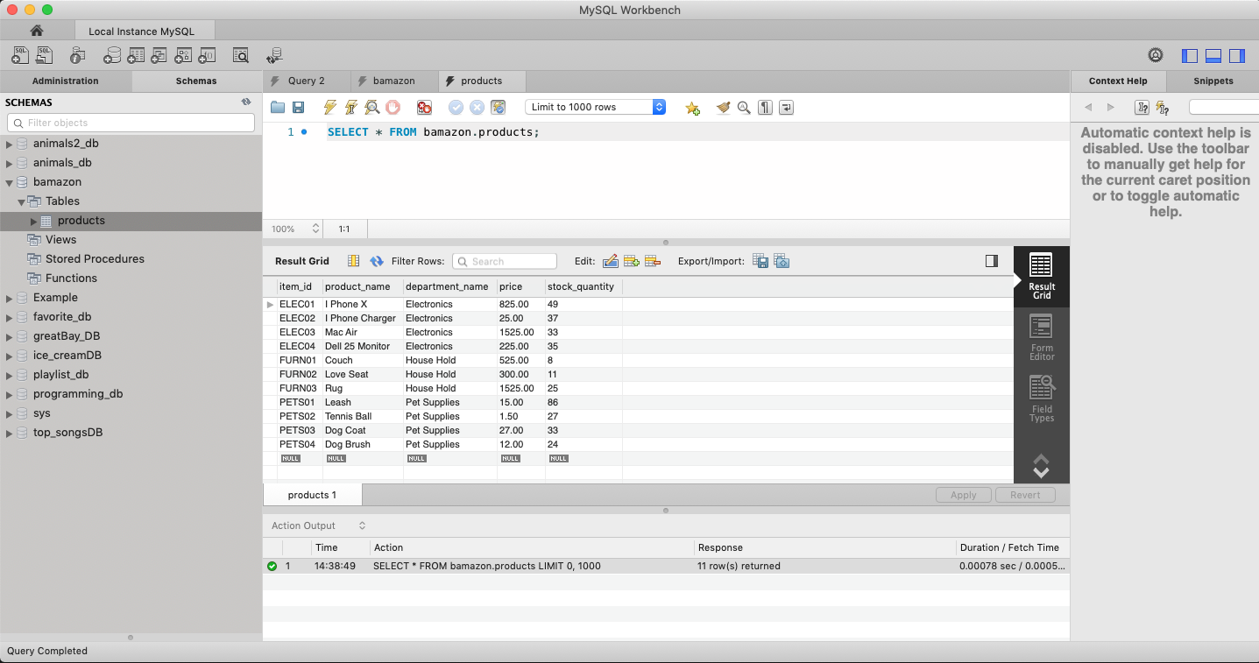
Starting Database Table
Note: 49 I Phones

Slide 2
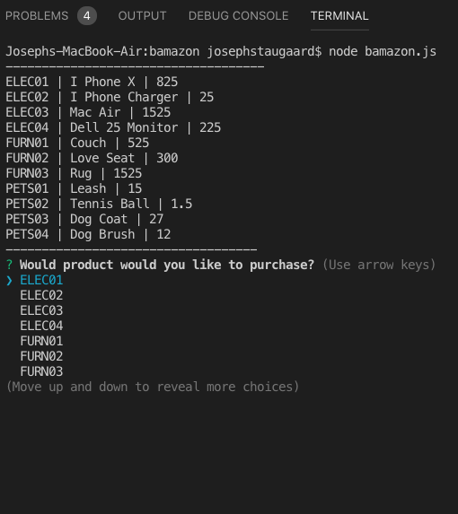
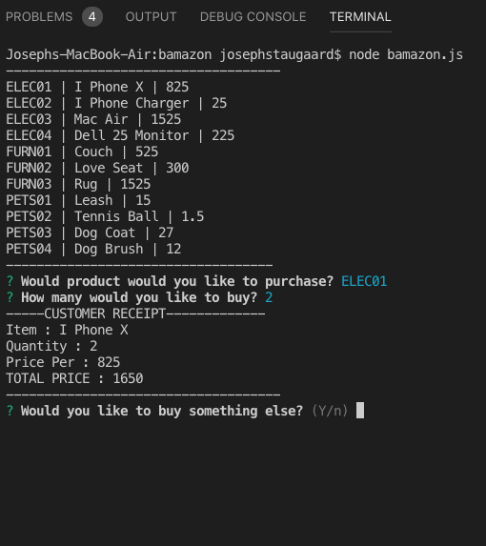
Node bamazon.js
Buy 2 I Phones
On execution, display products, followed by list of product ids
Total price calculated

Slide 3
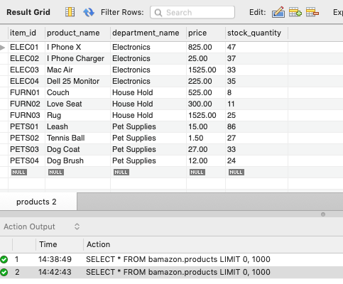
Resulting Database Table
Inventory reduced from 49 to 47

Slide 4
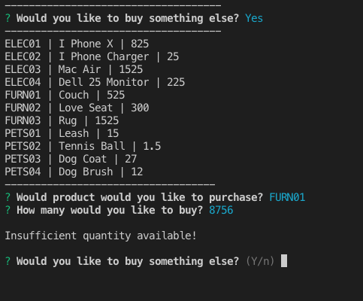
Quantity check, not enough
Tried to buy too many couches!

